Slide 1
2-3 Trees & Red-Black Trees
Initially prepared by Dr. İlyas Çiçekli; improved by various Bilkent CS202 instructors.

Slide 2
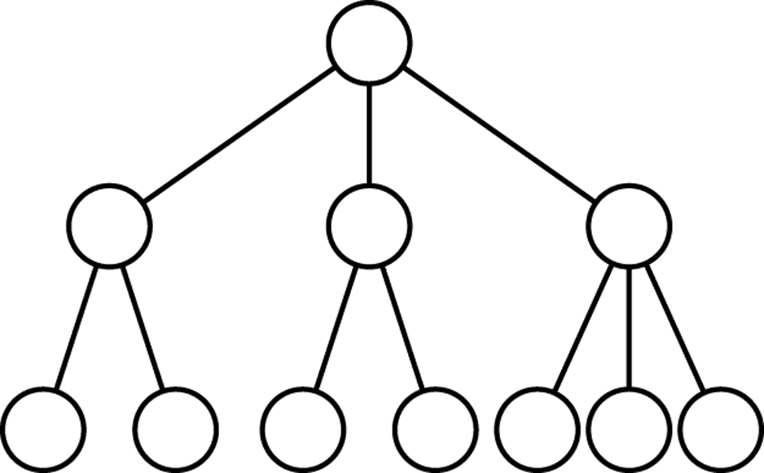
2-3 Trees
Definition:
A 2-3 tree is a tree in which each internal node has either two or three children, and all leaves are at the same level.
2-node: a node with two children
3-node: a node with three children
An example of a 2-3 tree
A 2-3 tree is not a binary tree
A 2-3 tree is never taller than a minimum-height binary tree
A 2-3 tree with N nodes never has height greater than ⎡ log2(N+1) ⎤
A 2-3 tree of height h always has at least 2^{h}-1 nodes.

Slide 3
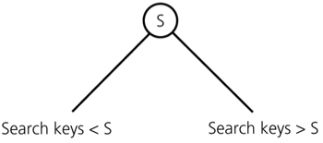
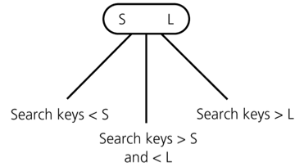
2-3 Trees
T is a 2-3 tree of height h if
T is empty (a 2-3 tree of height 0), or
T is of the form
where r is a node that contains one data item and T_{L} and T_{R} are both 2-3 trees, each of height h-1, or
T is of the form
where r is a node that contains two data items and T_{L} , T_{M} and T_{R} are 2-3 trees, each of height h-1.
2-node
r
T_{L}
T_{R}
3-node
r
T_{L}
T_{M}
T_{R}

Slide 4
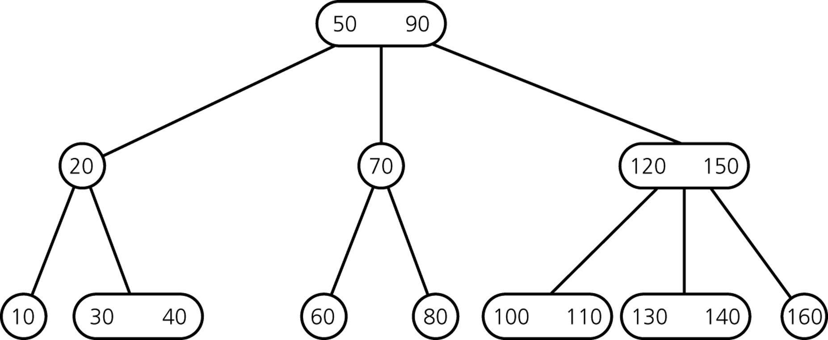
2-3 Trees -- Example

Slide 5
C++ Class for a 2-3 Tree Node
classTreeNode {
private:
TreeItemTypesmallItem, largeItem;
TreeNode *leftChildPtr, *midChildPtr, *rightChildPtr;
// friend class-can access private class members
friend classTwoThreeTree;
};
When a node is a 2-node (contains only one item)
Place it in smallItem
Use leftChildPtr and midChildPtr to point to the node’s children
Place NULL in rightChildPtr

Slide 6
Traversing a 2-3 Tree
Inorder traversal visits the nodes in a sorted search-key order
Leaf node:
Visit the data item(s)
2-node:
Visit its left subtree
Visit the data item
Visit its right subtree
3-node:
Visit its left subtree
Visit the smaller data item
Visit its middle subtree
Visit the larger data item
Visit its right subtree

Slide 7
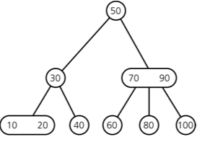
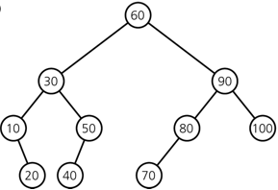
Searching a 2-3 Tree
Searching a 2-3 tree is similar to searching a binary search tree
For a 3-node, compare the searched key with the two values of the 3-node and select one of its three subtrees according to these comparisons
Searching a 2-3 tree is O(log N)
Searching a 2-3 tree and the shortest BST has approximately the same efficiency.
A binary search tree with N nodes cannot be shorter than ⎡log₂(N+1)⎤
A 2-3 tree with N nodes cannot be taller than ⎡log₂(N+1)⎤
A 2-3 tree with the same elements
A balanced binary search tree

Slide 8
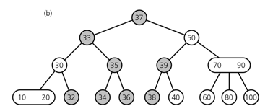
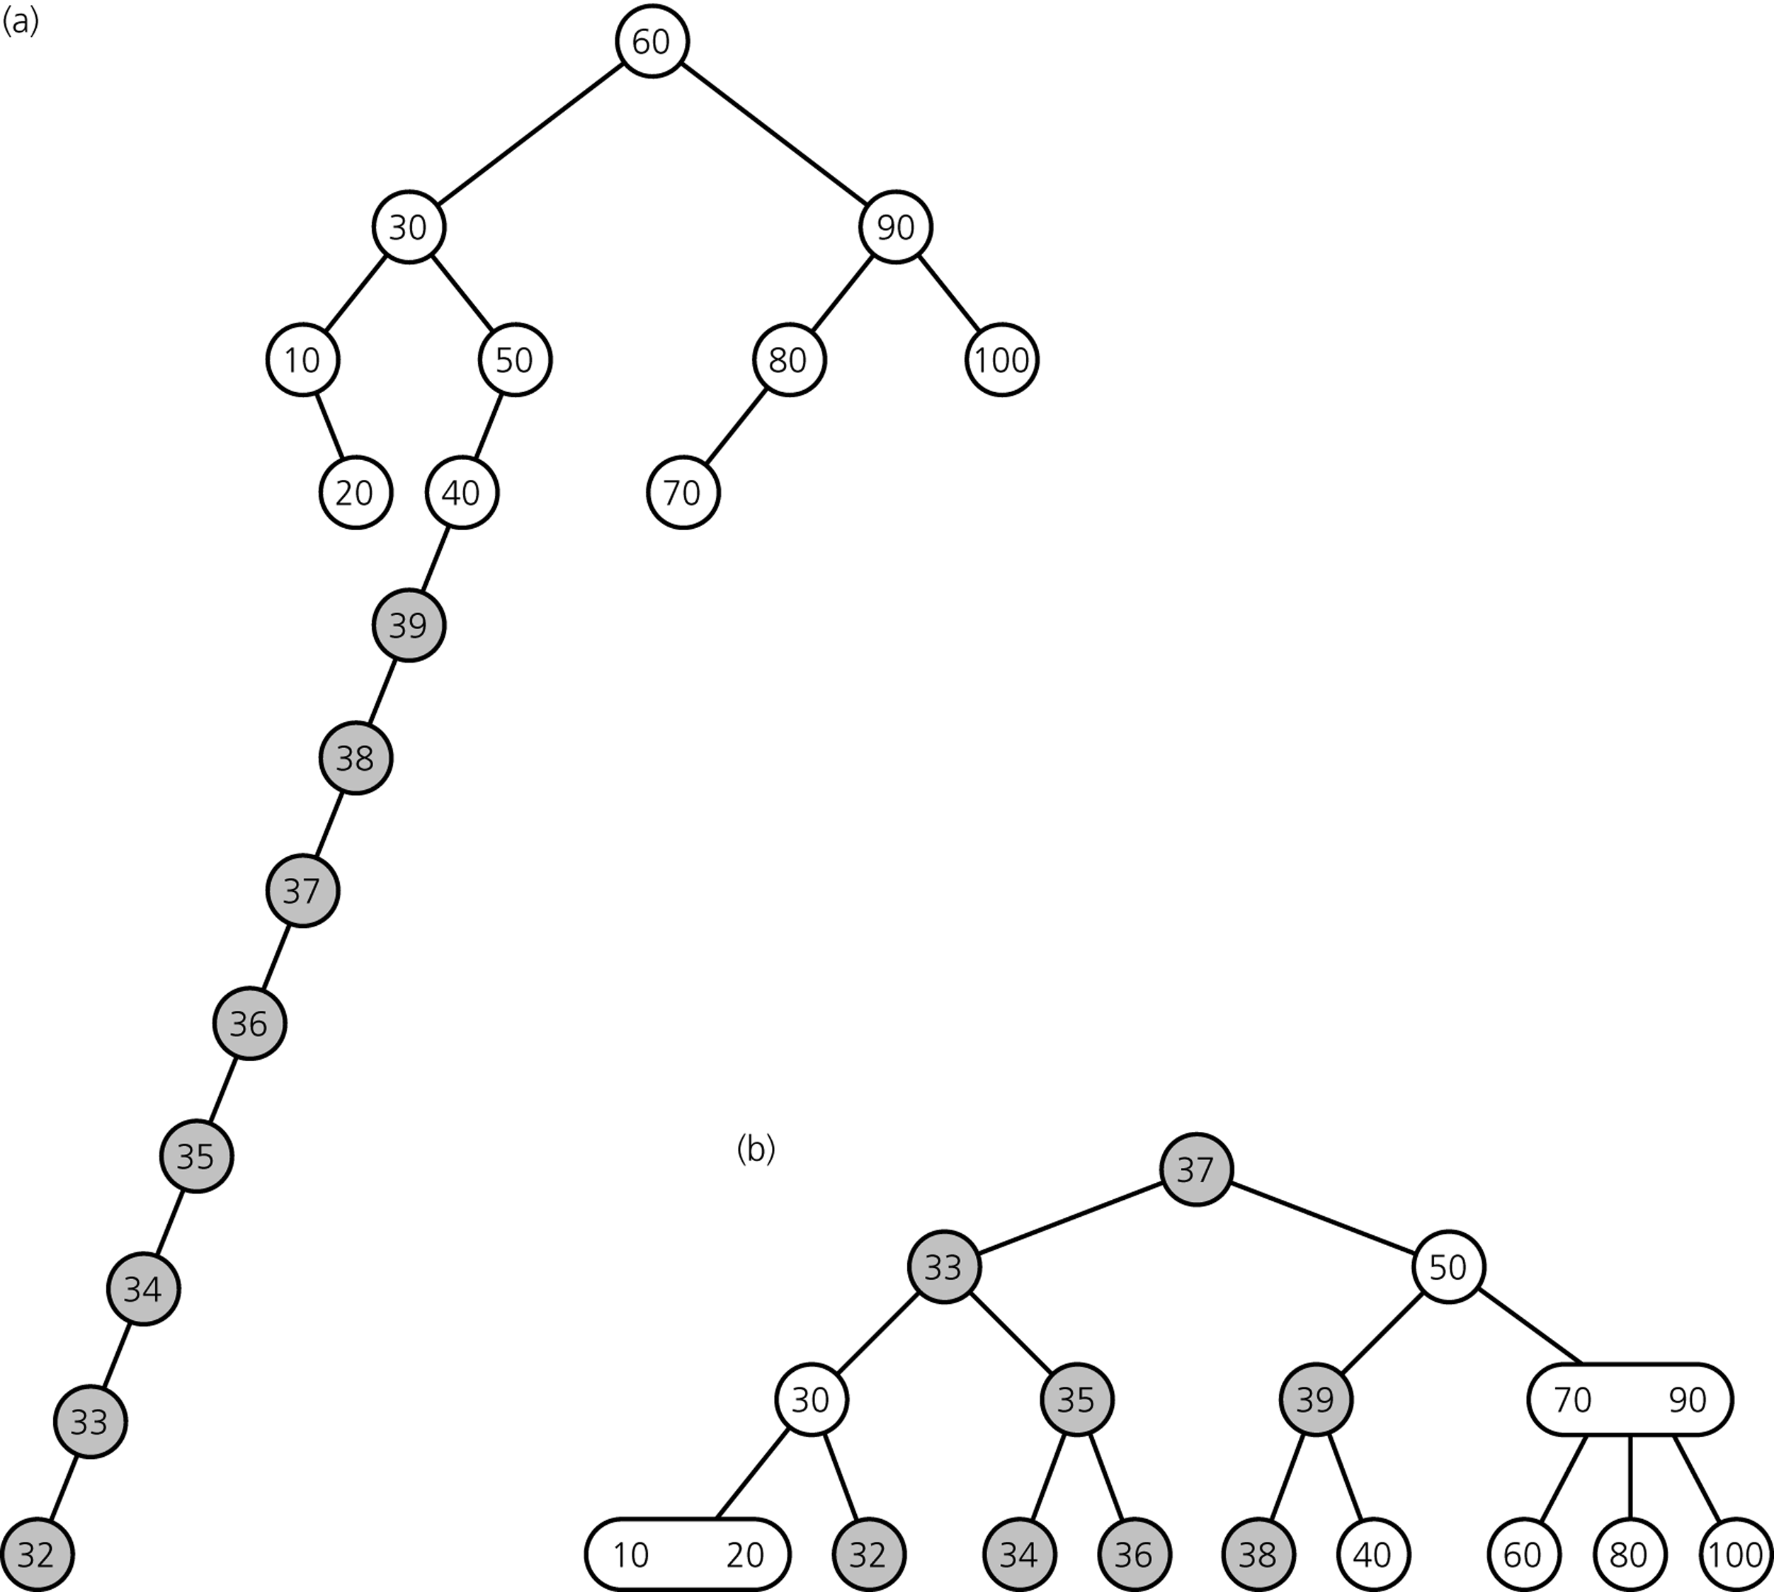
Inserting into a 2-3 Tree
Insert [ 39 38 37 36 35 34 33 32 ] into the trees given in the previous slide
While we insert items into a 2-3 tree, its shape is maintained

Slide 9

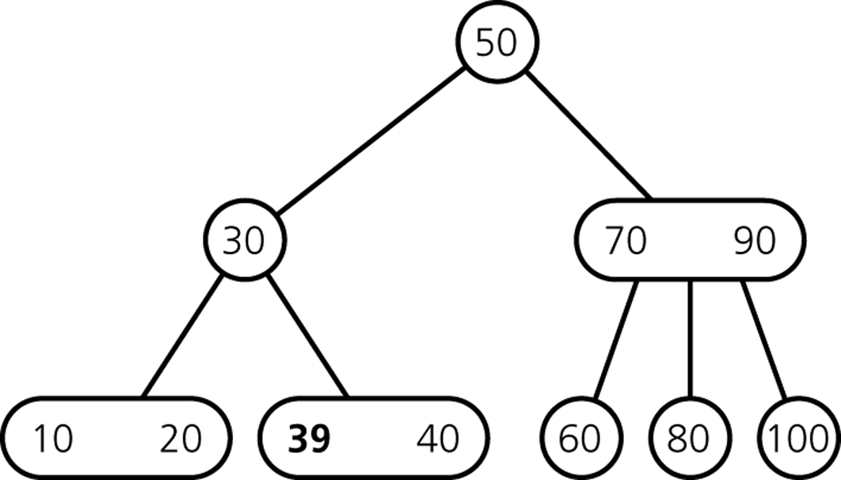
Inserting into a 2-3 Tree -- Example
Starting from the following tree, insert [ 39 38 37 36 35 34 33 32 ]
Insert 39
Insertion into a 2-node leaf is simple
Find the node into which you can put 39

Slide 10
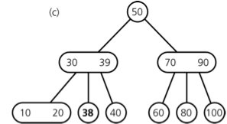
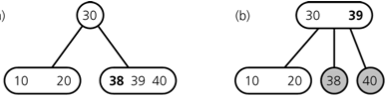
Inserting into a 2-3 Tree -- Example
Insert 38
Find the node into which you can put 38
Insertion into a 3-node causes it to divide

Slide 11
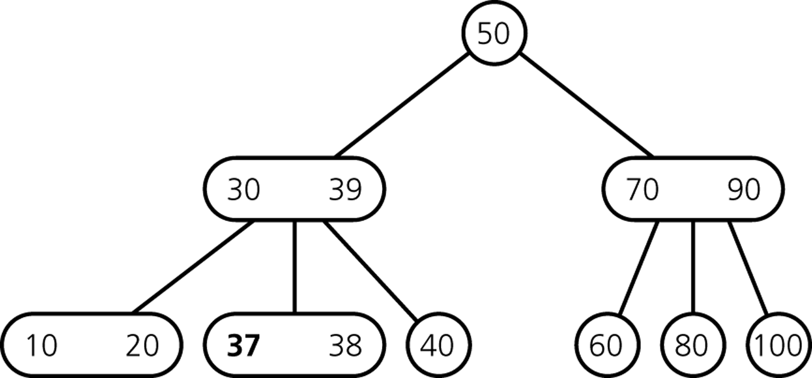
Inserting into a 2-3 Tree -- Example
Insert 37
Find the node into which you can put 37
Insertion into a 2-node leaf is simple

Slide 12
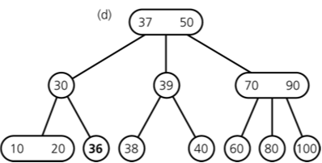
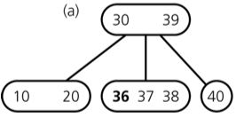
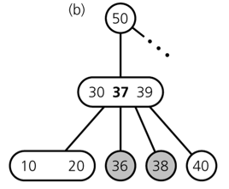
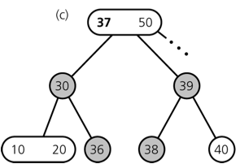
Inserting into a 2-3 Tree -- Example
Insert 36
Find the node into which you can put 36

Slide 13
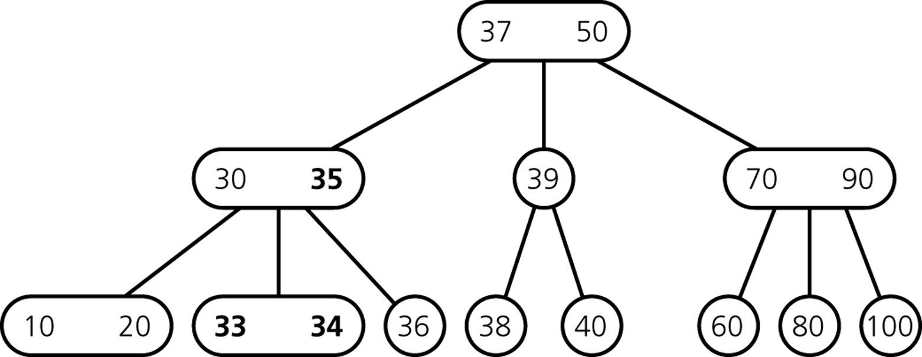
Inserting into a 2-3 Tree -- Example
Insert 35, 34, 33

Slide 14
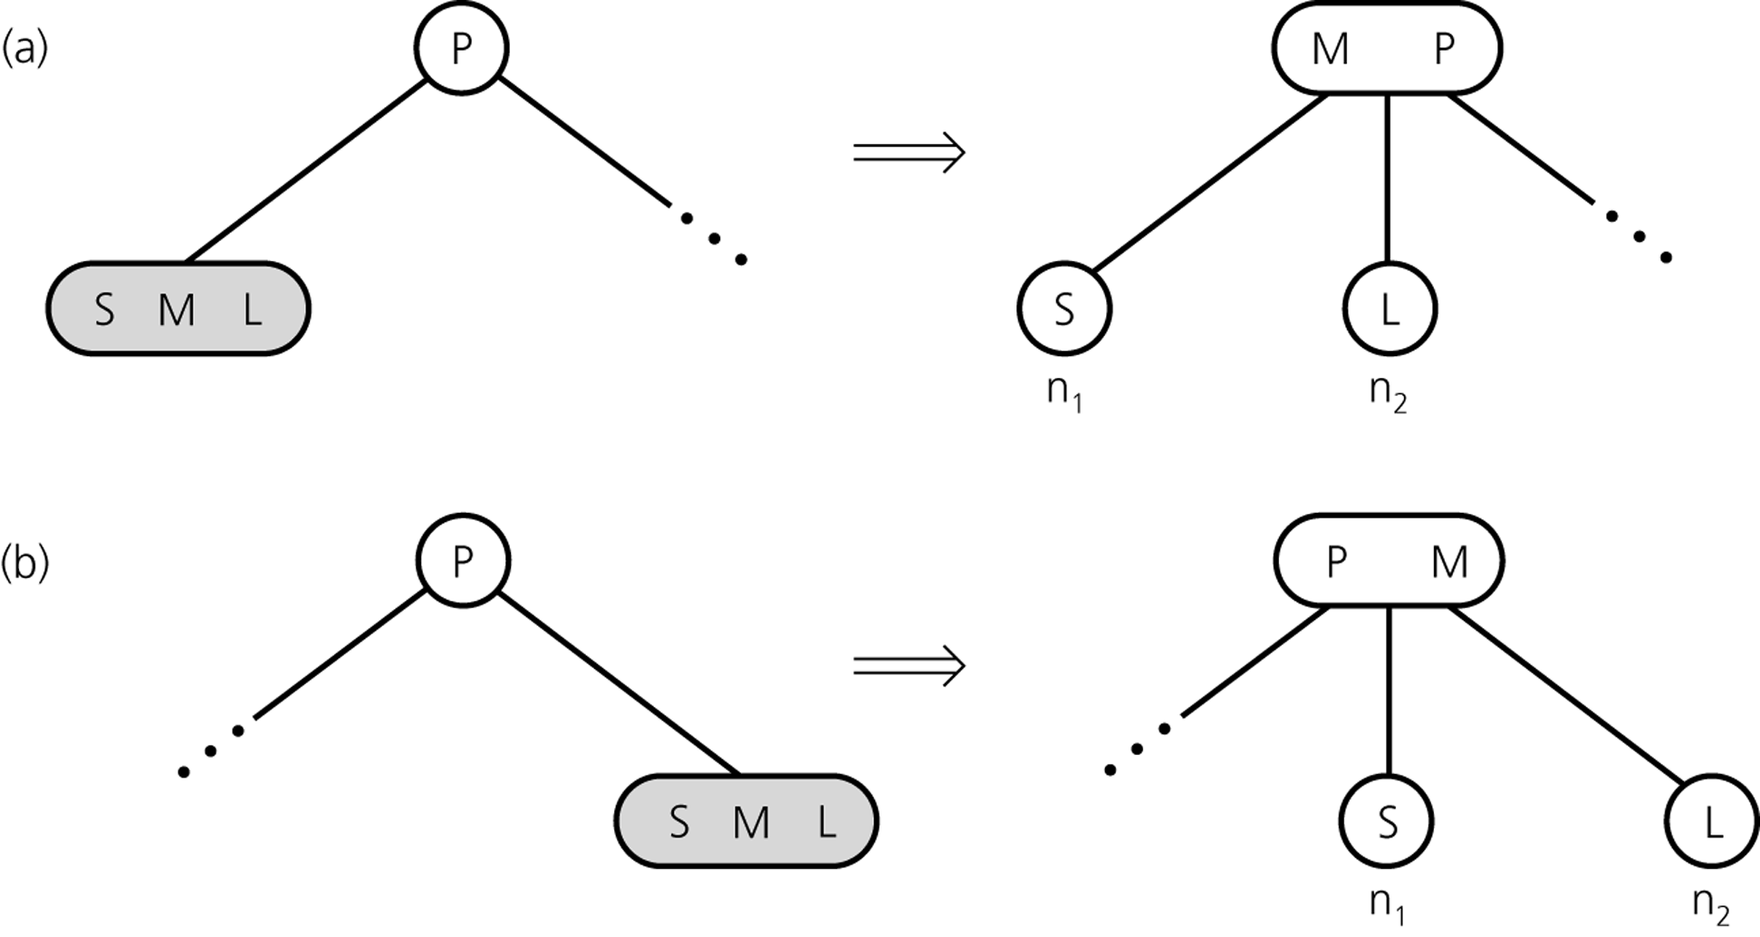
2-3 Trees -- Insertion Algorithm
Splitting a leaf in a 2-3 tree

Slide 15
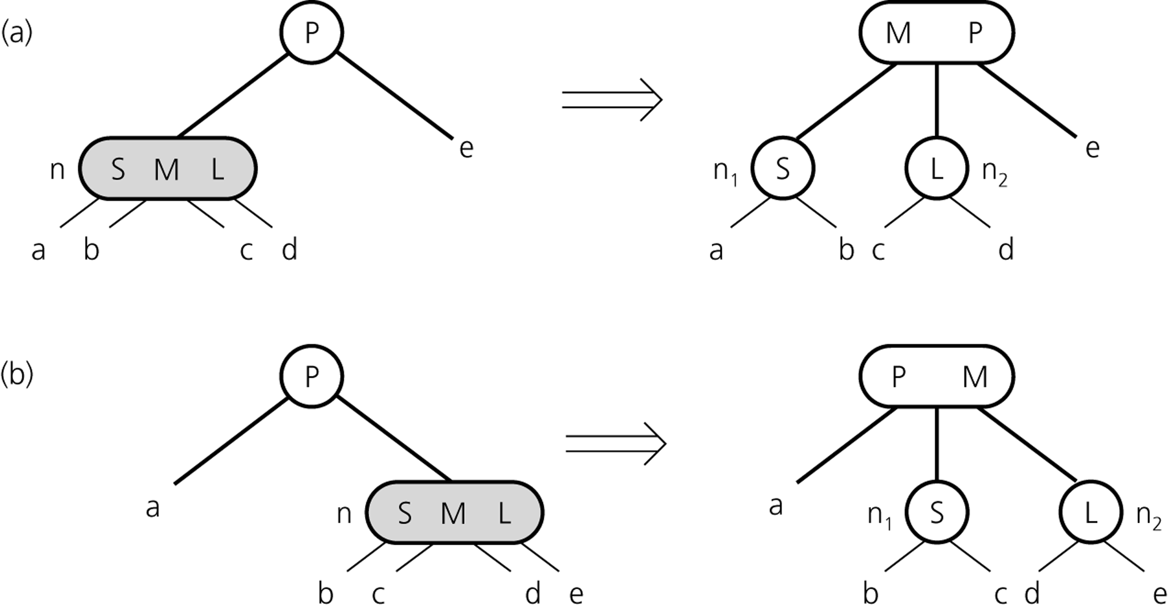
2-3 Trees -- Insertion Algorithm
Splitting an internal node in a 2-3 tree

Slide 16
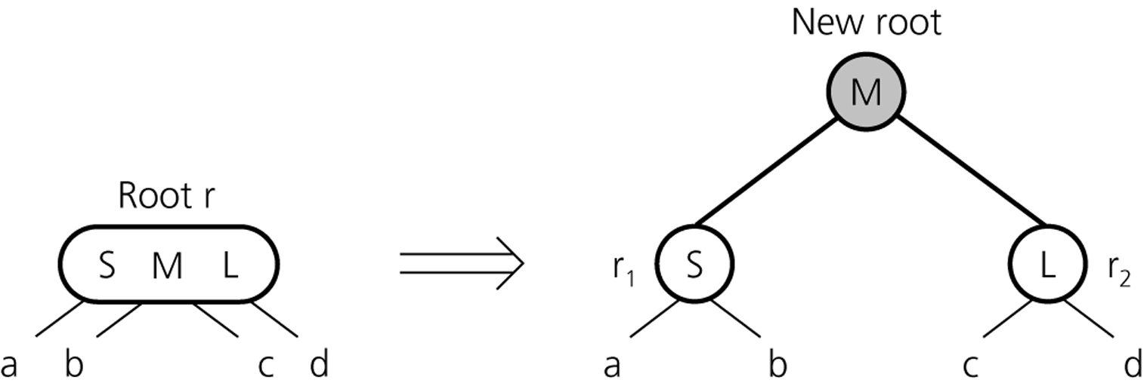
2-3 Trees -- Insertion Algorithm
Splitting the root of a 2-3 tree

Slide 17
Deleting from a 2-3 tree
Deletion strategy is the inverse of insertion strategy.
Deletion starts like normal BST deletion (swap with inorder successor)
Then, we merge the nodes that have become underloaded.
50
Delete [ 70 100 80 ] from this 2-3 tree
30
70 90
10 20
40
60
80
100

Slide 18
Deleting from a 2-3 Tree -- Example
50
50
50
50
50
50
30
30
30
30
30
30
70 90
80 90
80 90
80 90
90
90
Resulting tree
10 20
10 20
10 20
10 20
10 20
10 20
40
40
40
40
40
40
60 80
60 80
60
60
60
60
80
70
–
100
100
100
100
100
100
Delete 70
Swap with inorder successor
Delete value from leaf
Delete the empty leaf
Shrink the parent (no more mid-pointer)

Slide 19
Deleting from a 2-3 Tree -- Example
50
50
50
50
50
30
30
30
30
30
90
90
90
80
80
Resulting tree
10 20
10 20
10 20
10 20
10 20
40
40
40
40
40
60 80
60 80
60
60
60
–
100
80
90
90
Delete 100
Delete value from leaf
Distribute the children
→Doesn’t work
Redistribute the parent and the children

Slide 20
Deleting from a 2-3 Tree -- Example
50
–
Root becomes empty
50
50
50
30 50
30
30 50
30
30
30
90
90
–
80
Node becomes empty
10 20
40
60 90
10 20
10 20
10 20
10 20
10 20
40
40
40
40
40
60 90
60 90
60
60
60
80
–
90
Delete 80
Swap with inorder successor
Delete value from leaf
Merge by moving 90 down and removing the empty leaf
Merge by moving 50 down, adopting empty node’s child and removing the empty node
Remove empty root

Slide 21
2-3 Trees -- Deletion Algorithm
To delete an item X from a 2-3 tree:
First, we locate the node n containing X.
If n is not a leaf, we find X's inorder successor and swap it with X.
After the swap, the deletion always begins at the leaf.
If the leaf contains another item in addition to X, we simply delete X from that
leaf, and we are done.
If the leaf contains only X, deleting X would leave the leaf without a data item.
In this case, we must perform some additional work to complete the deletion.
Depending on the empty node and its siblings, we perform certain operations:
Delete empty root
Merge nodes
Redistribute values
These operations can be repeated all the way upto the root if necessary.

Slide 22
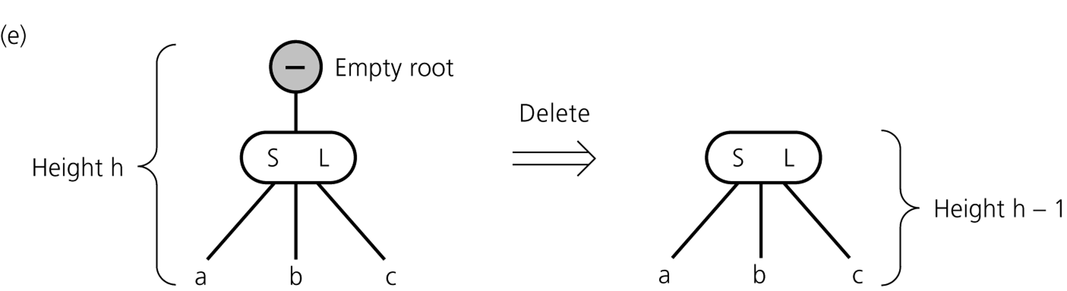
2-3 Trees -- Deletion Operations
Deleting the root

Slide 23
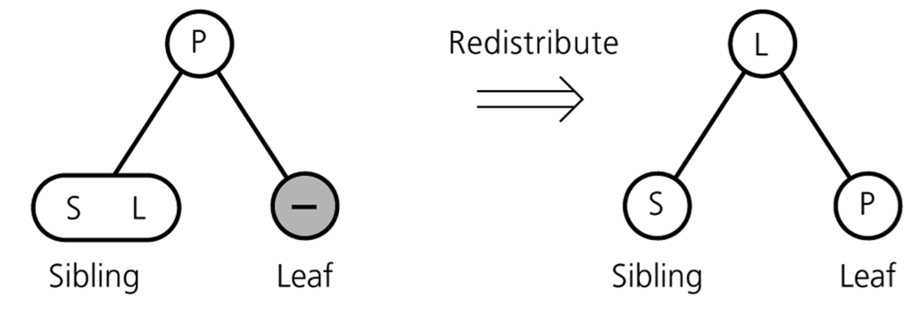
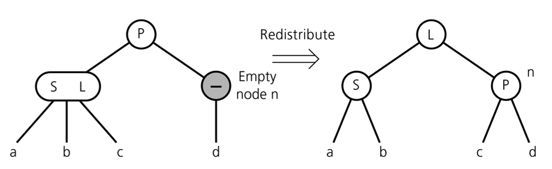
2-3 Trees -- Deletion Operations
Redistributing values (and children)
For a leaf
For an internal node

Slide 24
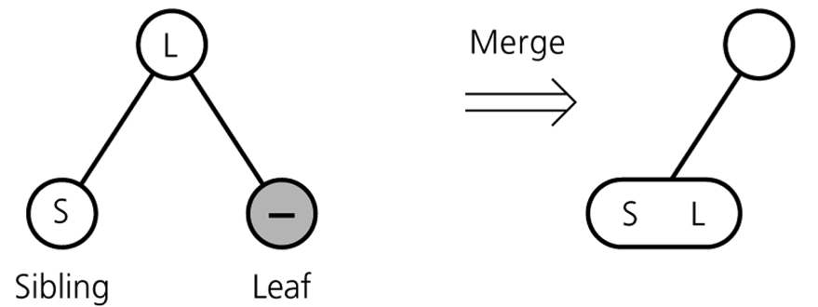
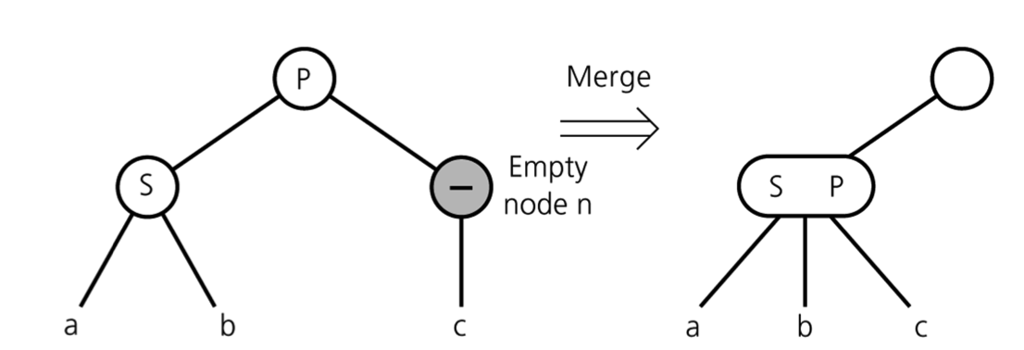
2-3 Trees -- Deletion Operations
Merging
For a leaf
For an internal node

Slide 25
2-3 Trees -- Analysis
We can use a 2-3 tree in the implementation of tables.
A 2-3 tree has the advantage of always being balanced.
Thus, insertion and deletion operations are O(log N)
Retrieval based on key is also guaranteed to O(log N)

Slide 26
2-3-4 Trees
A 2-3-4 tree is like a 2-3 tree, but it allows 4-nodes, which are nodes that have four children and three data items.
There is a close relation between 2-3-4 trees and red-black trees.
We will look at those a bit later
2-3-4 trees are also known as 2-4 trees in other books.
A specialization of M-way tree (M=4)
Sometimes also called 4th order B-trees
Variants of B-trees are very useful in databases and file systems
MySQL, Oracle, MS SQL all use B+ trees for indexing
Many file systems (NTFS, Ext2FS etc.) use B+ trees for indexing metadata (file size, date etc.)
Although a 2-3-4 tree has more efficient insertion and deletion operations than a 2-3 tree, a 2-3-4 tree has greater storage requirements.

Slide 27
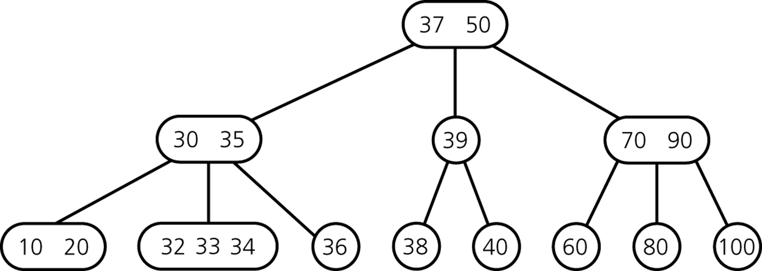
2-3-4 Trees -- Example

Slide 28
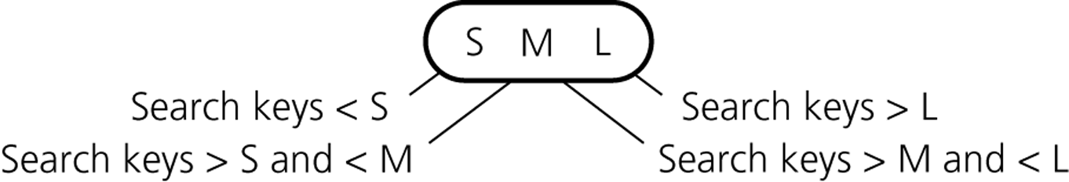
2-3-4 Trees
2-node
T is a 2-3-4 tree of height h if
T is empty (a 2-3-4 tree of height 0), or
T is of the form
where r is a node containing one data item and T_{L} and T_{R} are both 2-3-4 trees, each of height h-1, or
T is of the form
where r is a node containing two data items and T_{L} , T_{M} and T_{R} are 2-3-4 trees, each of height h-1, or
T is of the form
where r is a node containing three data items and T_{L} , T_{ML} , T_{MR} , and T_{R} are 2-3-4 trees, each of height h-1.
r
T_{L}
T_{R}
3-node
r
T_{L}
T_{M}
T_{R}
4-node
r
T_{L}
T_{ML}
T_{MR}
T_{R}

Slide 29
C++ Class for a 2-3-4 Tree Node
classTreeNode {
private:
TreeItemTypesmallItem, middleItem, largeItem;
TreeNode *leftChildPtr, *lMidChildPtr;
TreeNode *rMidChildPtr, *rightChildPtr;
friendclassTwoThreeFourTree;
};
When a node is a 3-node (contains only two items)
Place the items in smallItem and middleItem
Use leftChildPtr, lMidChildPtr, rMidChildPtr to point to the node’s children
Place NULL in rightChildPtr
When a node is a 2-node (contains only one item)
Place the item in smallItem
Use leftChildPtr, lMidChildPtr to point to the node’s children
Place NULL in rMidChildPtr and rightChildPtr

Slide 30
2-3-4 Trees -- Operations
Searching and traversal algorithms for a 2-3-4 tree are similar to the 2-3 algorithms.
For a 2-3-4 tree, insertion and deletion algorithms that are used for 2-3 trees, can similarly be used.
But, we can also use a slightly different insertion and deletion algorithms for 2-3-4 trees to gain some efficiency.

Slide 31
Inserting into a 2-3-4 Tree
Splits 4-nodes by moving one of its items up to its parent node.
For a 2-3 tree, the insertion algorithm traces a path from the root to a leaf and then backs up from the leaf as it splits nodes.
To avoid this return path after reaching a leaf, the insertion algorithm for a 2-3-4 tree splits 4-nodes as soon as it encounters them on the way down the tree from the root to a leaf.
As a result, when a 4-node is split and an item is moved up to node’s parent, the parent cannot possibly be a 4-node and so can accommodate another item.
Insert[ 20 50 40 70 80 15 90 100 ] to this 2-3-4 tree
10 30 60

Slide 32
Inserting into a 2-3-4 Tree -- Example
10 30 60
10 30 60
30
30
10 20
10
60
60
Insert 20
Root is a 4-node
→Split 4-nodes as they are encountered
So, we split it before insertion
And, then add 20

Slide 33
Inserting into a 2-3-4 Tree -- Example
30
30
30
10 20
10 20
10 20
40 50 60
50 60
60
Insert 50 and 40
No 4-nodes have been encountered during their insertion
→ No split operation

Slide 34
Inserting into a 2-3-4 Tree -- Example
30 50
30 50
30
30
10 20
10 20
10 20
10 20
40
40
40 50 60
40 50 60
60 70
60
Insert 70
A 4-node is encountered
So, we split it before insertion
And, then add 70

Slide 35
Inserting into a 2-3-4 Tree -- Example
30 50
30 50
30 50
10 15 20
10 20
10 20
40
40
40
60 70 80
60 70 80
60 70
Insert 80 and 15
No 4-nodes have been encountered during their insertion
→ No split operation

Slide 36
Inserting into a 2-3-4 Tree -- Example
30 50 70
30 50 70
30 50
30 50
10 15 20
10 15 20
10 15 20
10 15 20
40
40
40
40
60
60
60 70 80
60 70 80
80 90
80
Insert 90
A 4-node is encountered
So, we split it before insertion
And, then add 90

Slide 37
Inserting into a 2-3-4 Tree -- Example
50
50
30 50 70
30 50 70
10 1520
10 1520
40
40
60
60
80 90
30
80 90
30
70
70
10 15 20
10 15 20
40
40
60
60
80 90
80 90 100
Insert 100
A 4-node is encountered
So, we split it before insertion
And, then add 100

Slide 38
Splitting 4-nodes during insertion
We split each 4-node as soon as we encounter it during our search from the root to a leaf that will accommodate the new item to be inserted.
The 4-node which will be split can:
be the root, or
have a 2-node parent, or
have a 3-node parent.

Slide 39
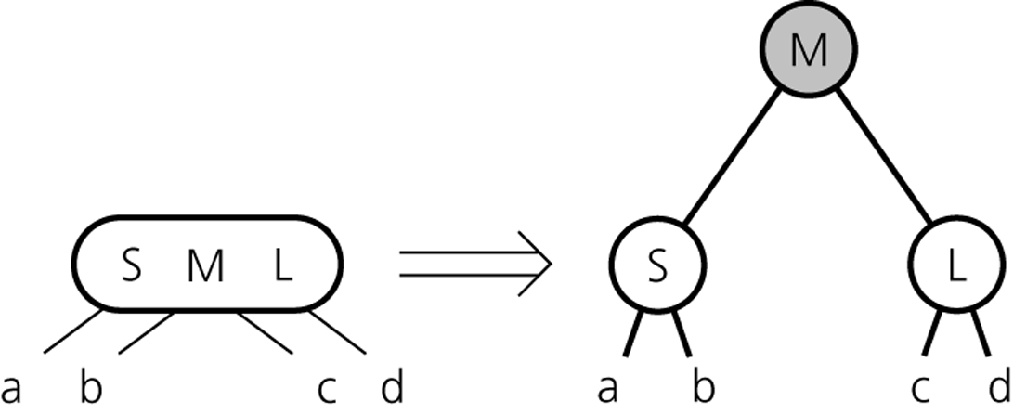
Splitting 4-nodes during insertion
Splitting a 4-node root

Slide 40
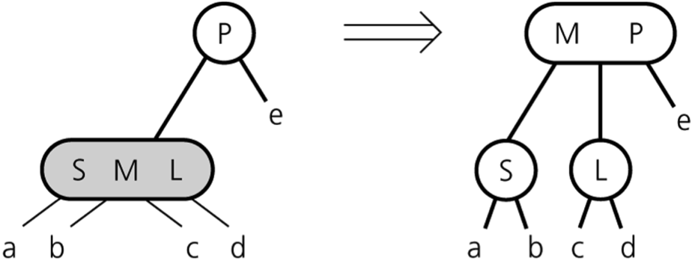
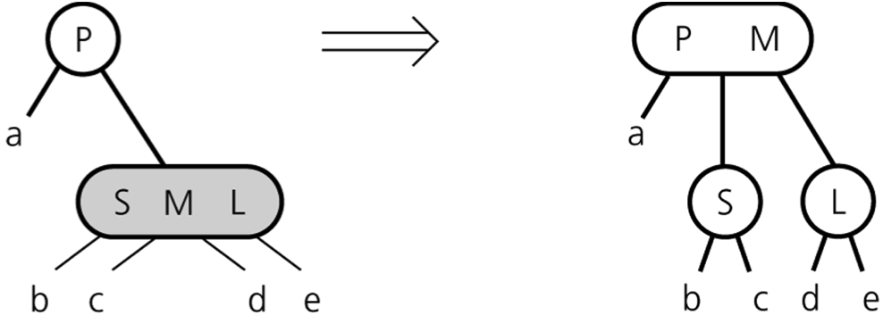
Splitting 4-nodes during insertion
Splitting a 4-node whose parent is a 2-node

Slide 41
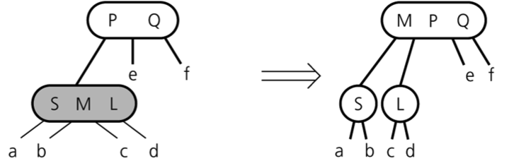
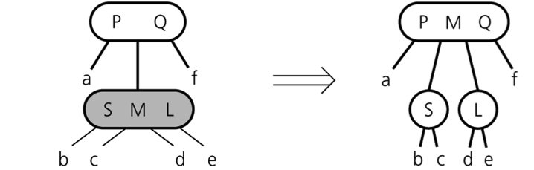
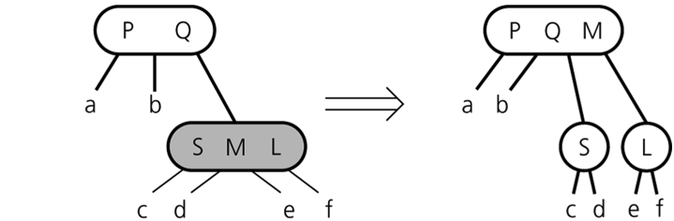
Splitting 4-nodes during insertion
Splitting a 4-node whose parent is a 3-node

Slide 42
Deleting from a 2-3-4 tree
For a 2-3 tree, the deletion algorithm traces a path from the root to a leaf and then backs up from the leaf, fixing empty nodes on the path back up to root.
To avoid this return path after reaching a leaf, the deletion algorithm for a 2-3-4 tree transforms each 2-node into either 3-node or 4-node as soon as it encounters them on the way down the tree from the root to a leaf.
If an adjacent sibling is a 3-node or 4-node, transfer an item from that sibling to our 2-node.
If adjacent sibling is a 2-node, merge them.

Slide 43
Red-Black Trees
In general, a 2-3-4 tree requires more storage than a binary search tree.
A special binary search tree, the red-black-tree, can be used to represent a 2-3-4 tree, so that we can retain advantages of a 2-3-4 tree without a storage overhead.
3-node and 4-nodes in a 2-3-4 tree are represented by a binary tree.
To distinguish the original 2-nodes from 2-nodes that are generated from 3-nodes and 4-nodes, we use red and black pointers.
All original pointers in a 2-3-4 tree are black pointers, red pointers are used for child pointers to link 2-nodes that result from the split of 3-nodes and 4-nodes.

Slide 44
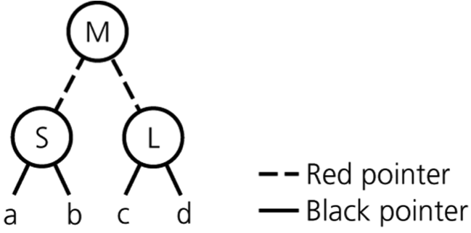
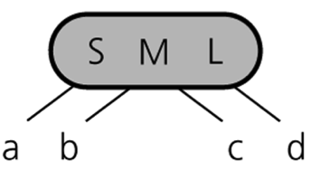
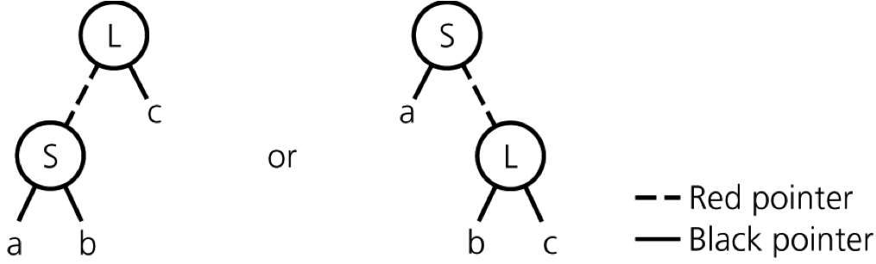
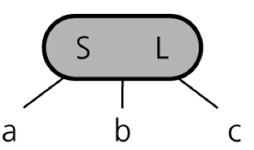
Red-Black Trees
Red-black tree representation
For a 4-node
For a 3-node

Slide 45
Red-Black Trees -- Properties
Root is always a black node.
The children of a red node (pointed by a red pointer) are always black nodes (pointed by a black pointer)
All external nodes (leaves and nodes with a single child) should have the same number of black pointers on the path from the root to that external node.

Slide 46
A 2-3-4 Tree and Its Corresponding Red-Black Tree
37 50
30 35
39
70 90
10 20
32 33 34
36
38
40
60
80
100
37
30
50
20
35
39
90
10
33
36
38
40
70
100
32
34
60
80

Slide 47
C++ Class for a Red-Black Tree Node
enum Color {RED, BLACK};
classTreeNode {
private:
TreeItemType Item;
TreeNode *leftChildPtr, *rightChildPtr;
Color leftColor, rightColor;
friendclassRedBlackTree;
};

Slide 48
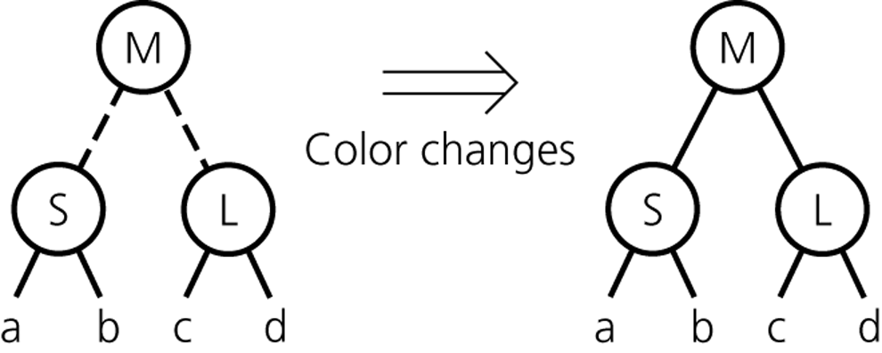
Splitting in a Red-Black Tree Representation
For a 4-node that is the root

Slide 49

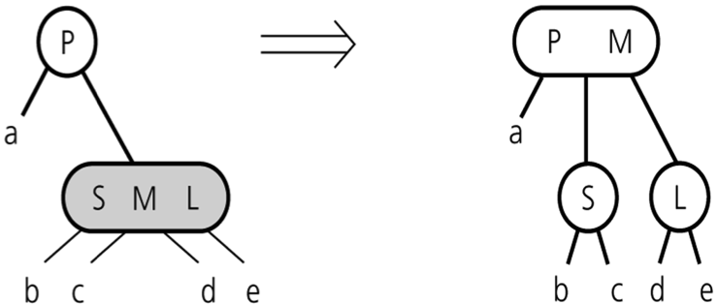
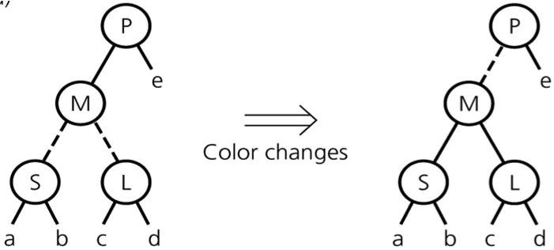
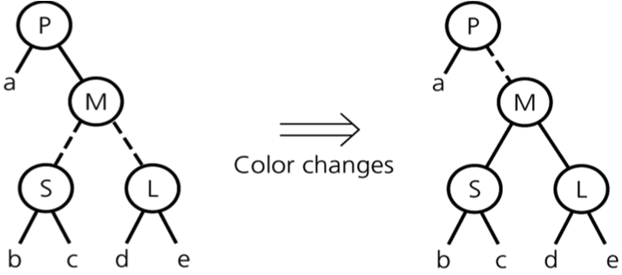
Splitting in a Red-Black Tree Representation
For a 4-node whose parent is a 2-node

Slide 50
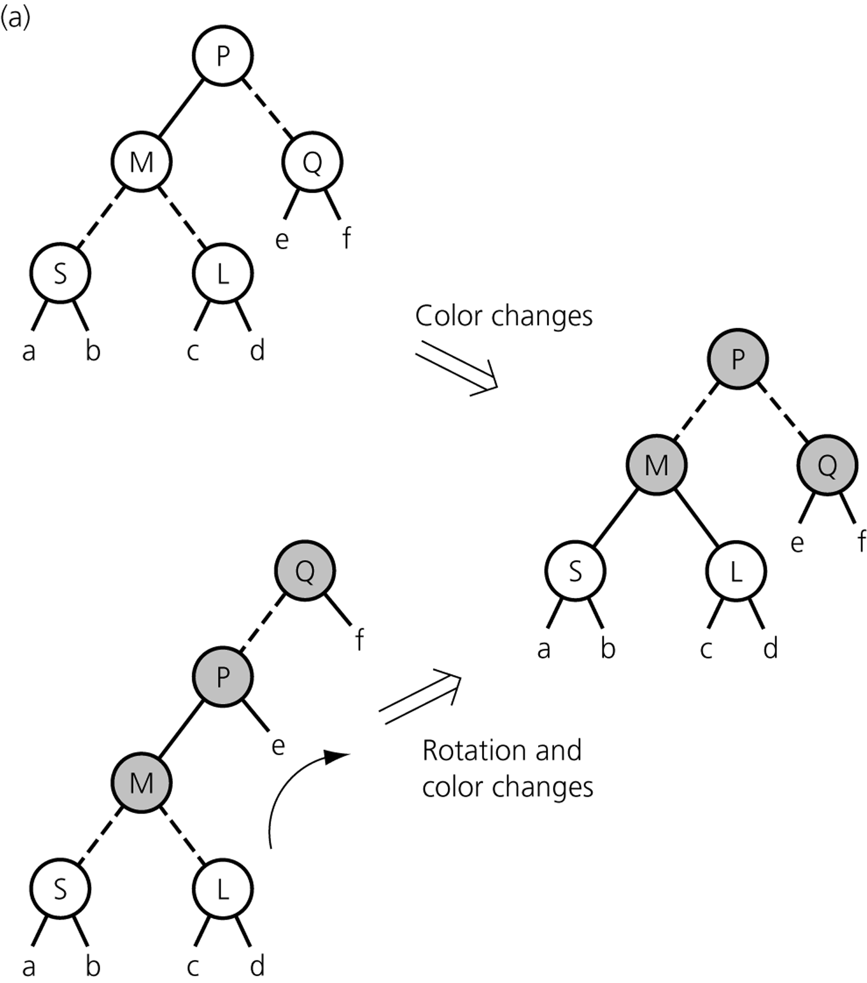
Splitting in a Red-Black Tree Representation
For a 4-node whose parent is a 3-node

Slide 51
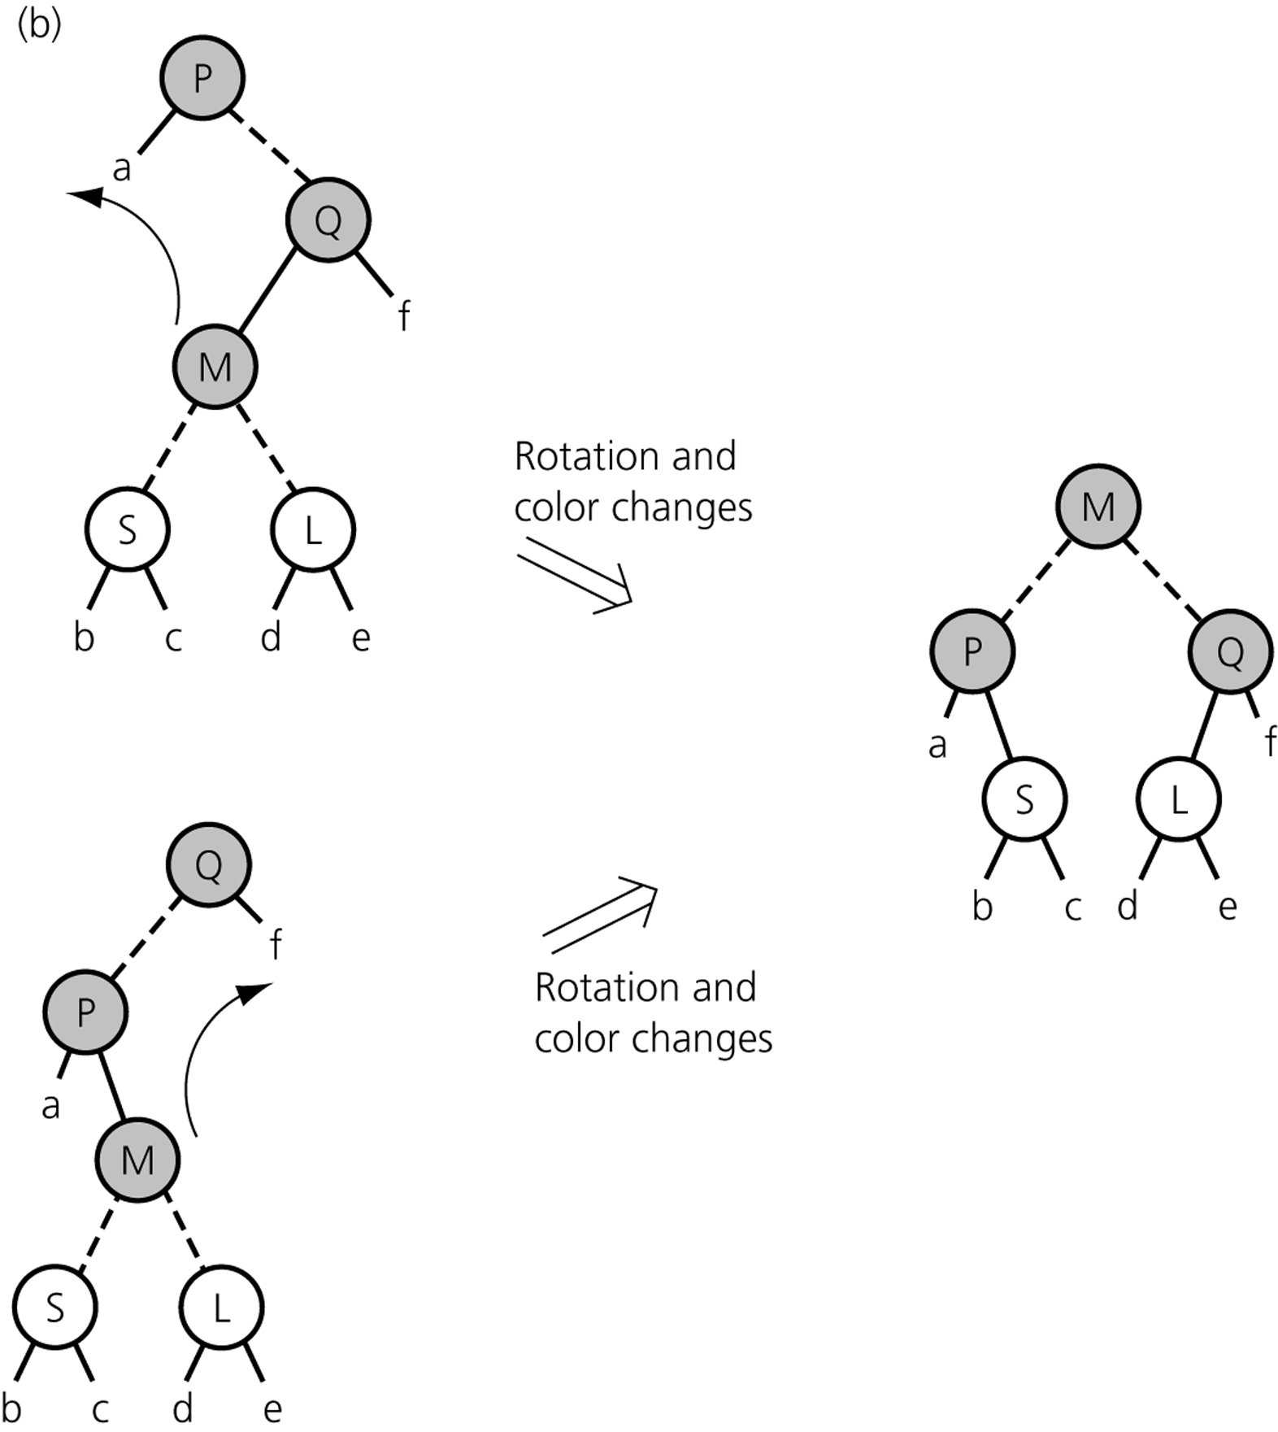
Splitting in a Red-Black Tree Representation
For a 4-node whose parent is a 3-node

Slide 52
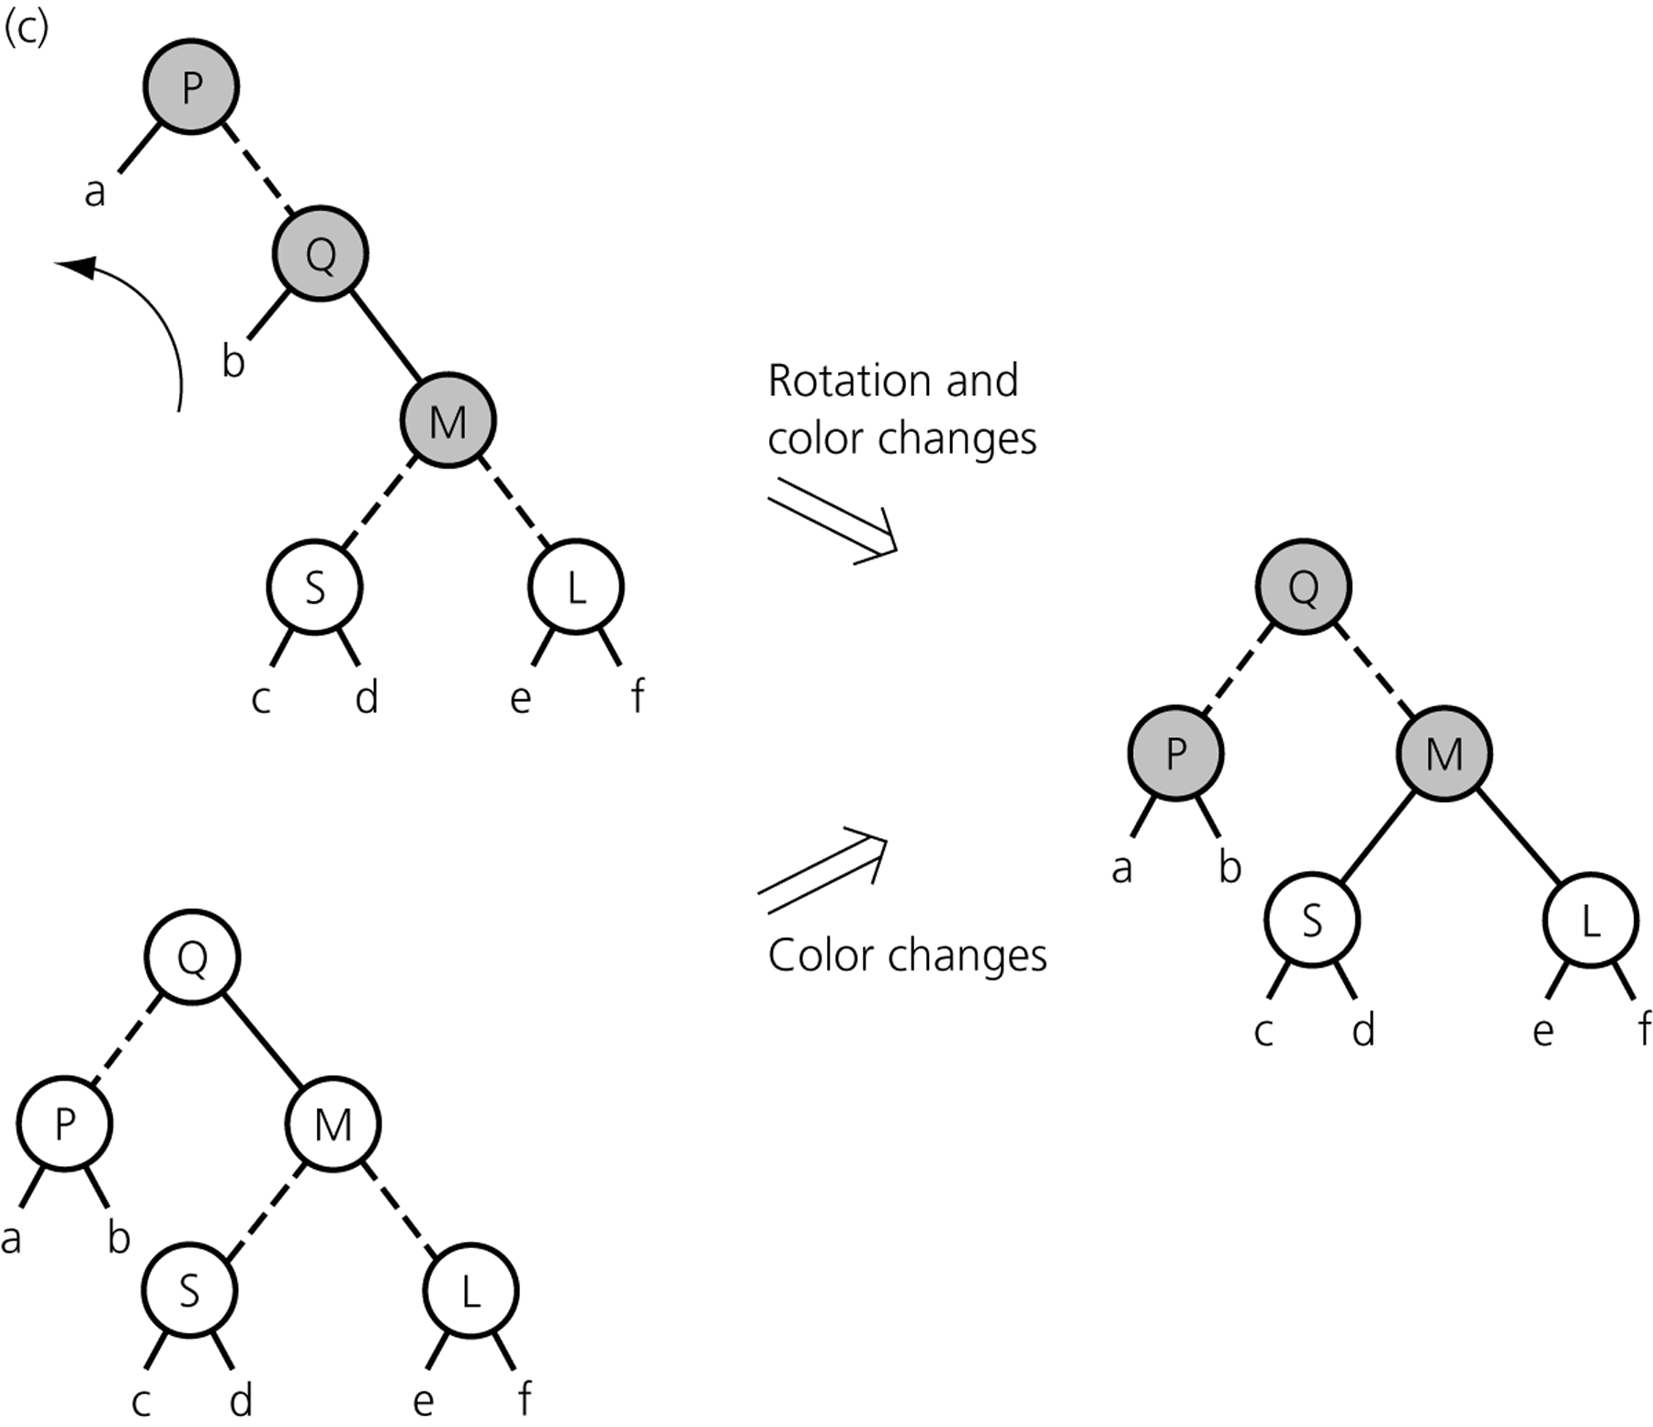
Splitting in a Red-Black Tree Representation
For a 4-node whose parent is a 3-node

